Slide 1
Market basket analysis using data science
Kyle Rocha
Data Science Platform
Notes:
Hi! My name is Kyle Rocha and my Summer project was market basket analysis using data science.

Slide 2
Agenda
About Me
Project Overview
Process
Conclusion
Questions
Notes:
Here is the agenda for todays presentation:
I’m going to begin by talking a little about myself
Then I will give an overview of my project and the concepts presented within it
I will then go over how a market basket analysis is done using real Albertson’s data
Finally I will conclude with “What’s Next?” for my project and how market basket analysis with Python will be a powerful tool for Albertson’s in the near future.

Slide 3


About Me
From Castro Valley, CA in SF Bay Area
Senior attending college at San Diego State University
Major: Business Administration
Minor: Management
Graduating in May 2020
Notes:
I’m originally from the San Francisco Bay Area
Fun fact: My home in the Bay is 15 minutes away from the Pleasanton office.
My major at San Diego State is business administration with a minor in management.
Graduating in May 2020
While attending school in San Diego, I worked at Albertson’s store 710. In my project, I analyzed data from my store!
This Summer I worked on the data science platform on the 3rd floor of DV1.

Slide 4
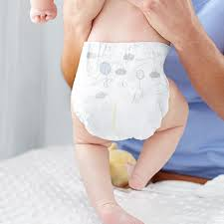
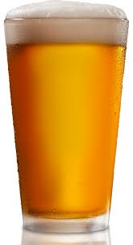
Did you know?
Notes:
One of the most famous market basket analysis examples is {Diapers} → {Beer}. It was found that fathers going into the grocery store to pick up diapers would also add beer to there basket. This association rule makes sense because after changing stinky diapers anyone would want a beer.

Slide 5
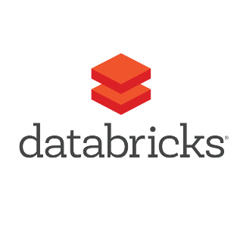

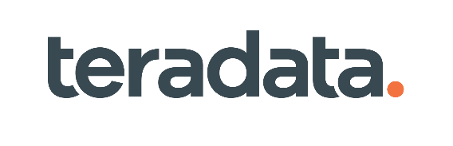
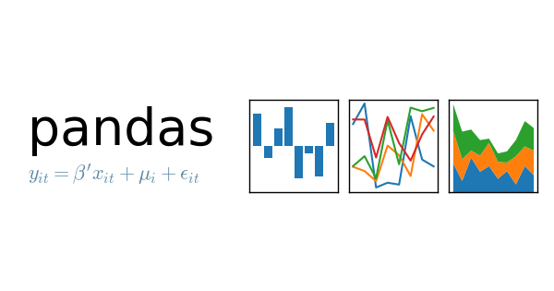
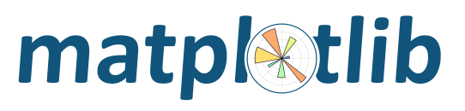

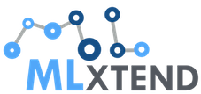
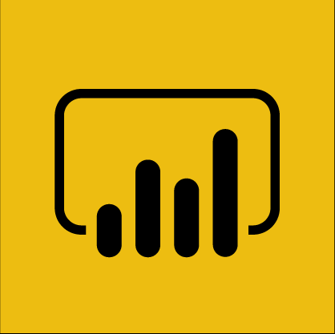
Market basket analysis with python
A data analysis technique to measure patterns and attributes of our customers transactions with association analysis.
Ex. {Diapers} → {Beer}.
Diapers = Antecedent. → = Association Rule. Beer = Consequent.
Data | Logic | Data Story
Transactional data with TXN_ID and PROD_ID | MLxtend: Used to implement the Apriori algorithm. | Generate association rules in Python. Visualize association rules using Python and Power BI.
Notes:
What does it take?
Read definition for market basket analysis
Connect diapers and beer example to definition
There are 2 fundamental ingredients needed to perform a market basket analysis
Data: Transactional data with TXN_ID and PROD_ID from Teradata. In the future the data will be sourced from our Azure cloud database.
Algorithm/Logic: Many different algorithms can be used to generate association rules. The most popular algorithm to implement market basket analysis with Python is the Apriori algorithm. With data and the Apriori algorithm, we can tell a story about how our products are associated.
Data Story: Once association rules are generated by the algorithm, we can choose to visualize the data in many ways. Including various Python visualization libraries (ex. Matplotlib) and Microsoft’s Power BI.
Market basket analysis is more than just diapers and beer. In order to find associations rules, here are some important concepts:
An itemset ({}) is a collection of items purchased by a customer in a transaction aka what you see on your receipt/basket.
Association rules between itemsets are determined by a minimum support, confidence, and lift threshold.
Itemsets with rules that have a strong support, confidence, and lift are the most actionable associations.
With Python, we can run the Apriori algorithm upon our transactional data and find buying patterns between the baskets.

Slide 6
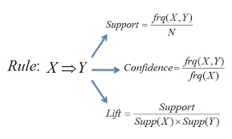
Association rules
An association rule is an implication expression of the form X → Y, where X and Y are disjoint itemsets. The strength of an association rule can be measured in terms of:
Support
Confidence
Lift
Notes:
Shortly go over definition of an association rules before showing the example on the next slide…

Slide 7
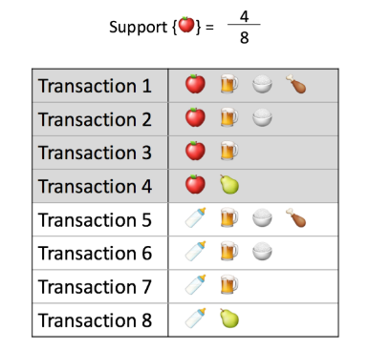
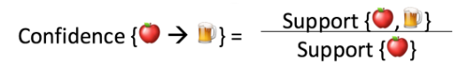
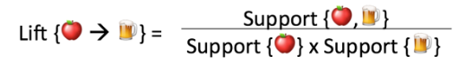
Support, confidence and Lift
Support{Beer} = 6/8 = 0.75
= 0.5
= 0.375 / 0.5 = .75
= .375 / (0.5 x 0.75) = 1
Support{Apple, Beer} = 3/8 = 0.375
Notes:
Let’s see how support, confidence, and lift are calculated:
Support: This says how popular an itemset is, as measured by the proportion of transactions in which an itemset appears. In the following 8 transactions, the support of {apple} is 4 out of 8, or 50%. Itemsets can also contain multiple items. For instance, the support of {apple, beer, rice} is 2 out of 8, or 25%. If you discover that sales of items beyond a certain proportion tend to have a significant impact on your profits, you might consider using that proportion as your support threshold. You may then identify itemsets with support values above this threshold as significant itemsets.
Confidence: This says how likely item Y is purchased when item X is purchased, expressed as {X -> Y}. This is measured by the proportion of transactions with item X, in which item Y also appears. In this example, the confidence of {apple -> beer} is 3 out of 4, or 75%. One drawback of the confidence measure is that it might misrepresent the importance of an association. This is because it only accounts for how popular apples are, but not beers. If beers are also very popular in general, there will be a higher chance that a transaction containing apples will also contain beers, thus inflating the confidence measure. To account for the base popularity of both constituent items, we use a third measure called lift.
Lift: This says how likely item Y is purchased when item X is purchased, while controlling for how popular item Y is. In this example, the lift of {apple -> beer} is 1, which implies no association between items. Lift controls for the support or (frequency) of the consequent while calculating the conditional probability of the occurrence of {Y} given {X}. A lift value greater than 1 means that item Y is likely to be bought if item X is bought, while a value less than 1 means that item Y is unlikely to be bought if item X is bought.

Slide 8
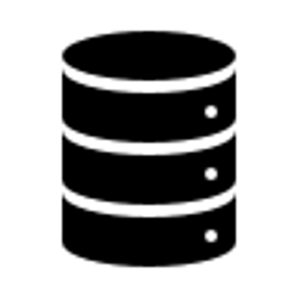
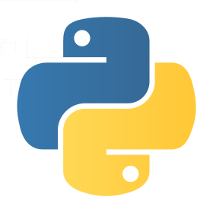
Process
Determine what type of transactional data you would like to analyze (Store, region, date, product hierarchy, etc.).
Process and clean the data to prepare for association analysis in Python.
Perform an association analysis with the Apriori algorithm to find frequent itemsets (Min.Sup. threshold) and generate rules (Min.Con. threshold).
Apriori Algorithm: If an itemset is frequent, then all its subsets must also be frequent. The Apriori algorithm eliminates any products that are not frequent.
Visualize association rules using Power BI and Python visualization libraries.
Notes:
Choose and Process Data: First we must determine what transactional data we would like to analyze. As mentioned before, my transactional data is sourced from Teradata. In order to generate quality association rules and keep the dataset small, I chose products on a class level. Looking at products on a upc level was too granular and produced poor association rules. With the use of Pythons extensive libraries, the data is cleaned and processed for the Apriori algorithm.
Algorithm: Once the data is processed, it is ready for the algorithm. Apriori works by saying: If an itemset is frequent, then all its subsets must also be frequent. The Apriori algorithm eliminates any products that are not frequent. To select interesting rules we can use the best-known constraints which are a minimum threshold on support and confidence.
Visualize: The association rules are then visualized directly with Python or exported to be visualized with Power BI
For visualization at bottom of screen: Data is extracted from Teradata → Association rules are generated by Apriori → Results loaded back to Teradata for visualization.
To select interesting rules we can use the best-known constraints which are a minimum thresholds on support and confidence.

Slide 9
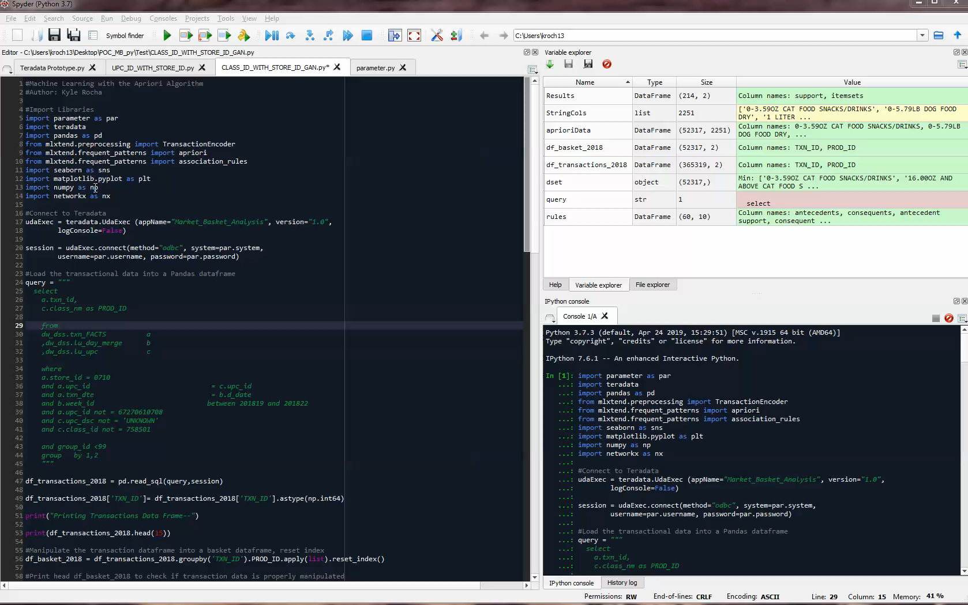
Notes:
Libraries are imported
A connection is established to Teradata and a query is executed to import TXN_ID and PROD_ID into a Pandas dataframe
This dataframe of transactions is printed in the console
Next we need to manipulate the dataframe into baskets to prepare for the Apriori algorithm, also printed out in the console
The Apriori algorithm ingests this data and finds frequent itemsets and generates association rules based on a user given minimum support and lift threshold.
I’ll expand the association rules dataframe so we can see the antecedents and consequents. The next columns in the dataframe are the metrics of support, confidence, and lift.

Slide 10
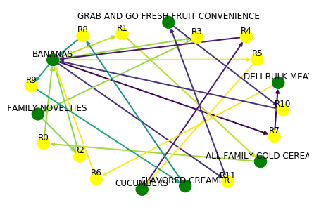
Python visualization with networkX
Notes:
To represent association rules as a network diagram, NetworkX is utilized. Arrows are drawn in different colors to represent association rules. The node R0 identifies one rule, that will have always incoming and outcoming edges.
If we take a closer look at rule R0, we see an incoming arrow from “ALL FAMILY COLD CEREAL” go to R0, then an outgoing arrow to “BANANAS”
In the future, we will be able to click on a product in the network map and only see the rules that are associated with it.

Slide 11
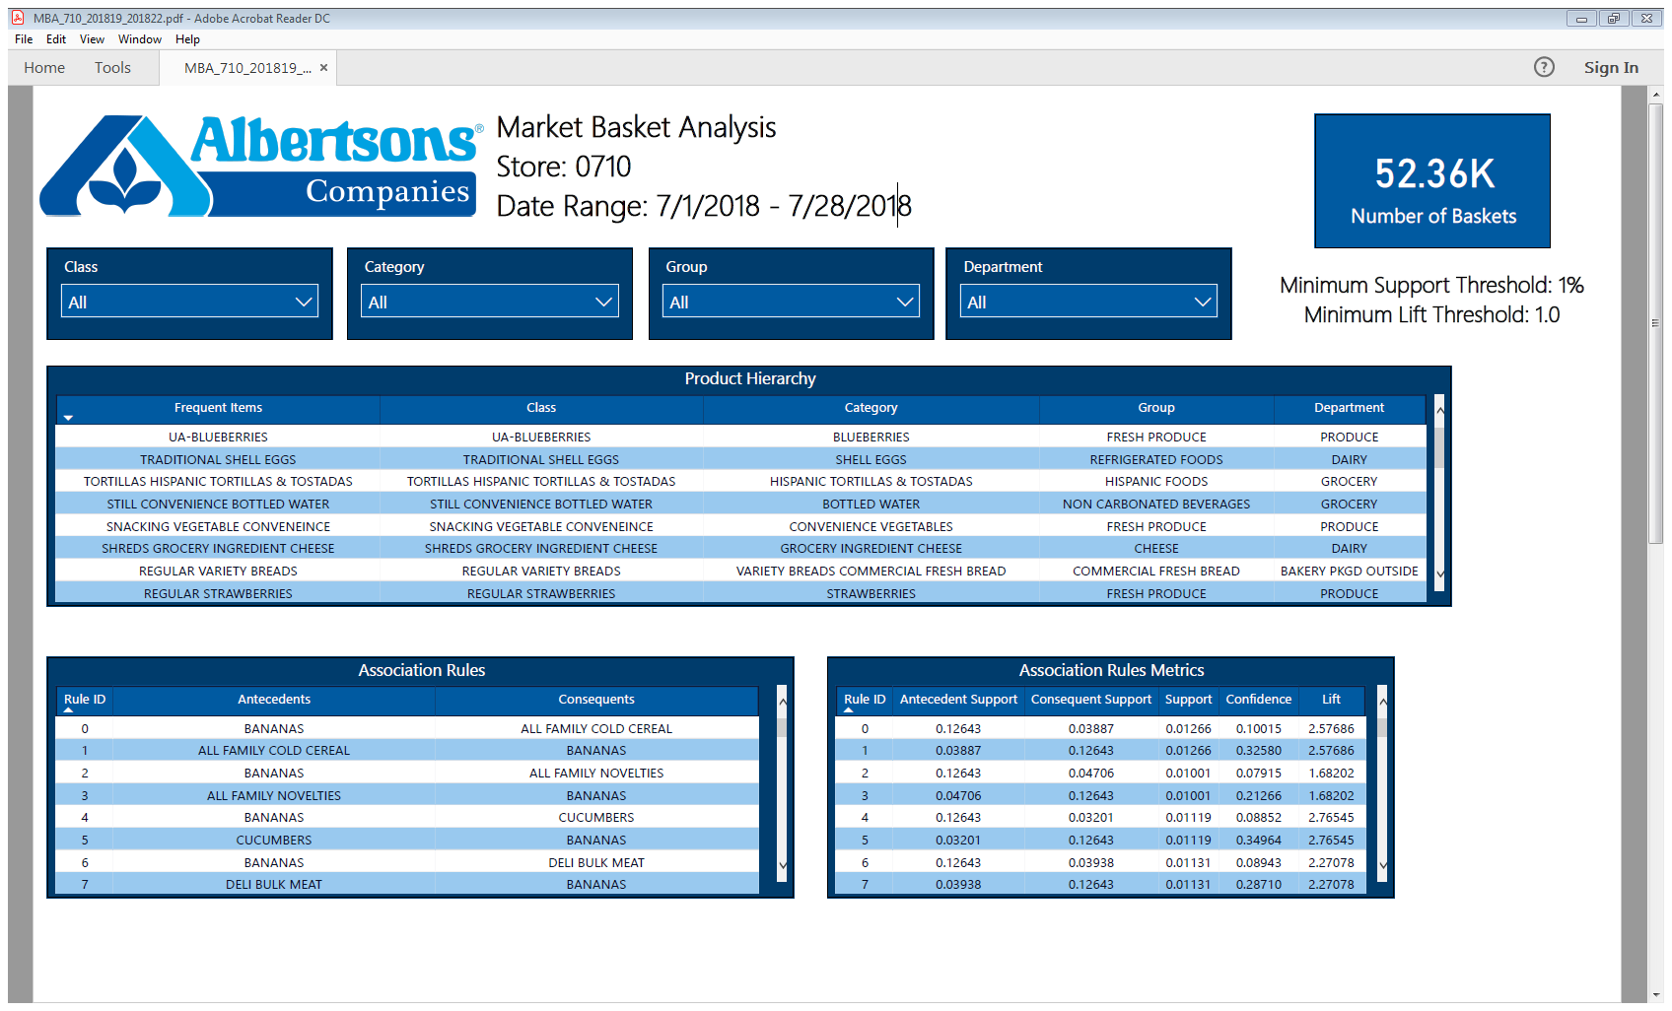
Report in power BI
Notes:
Now that you understand how market basket analysis is done and how it may help the business, you’re probably wondering how do we get this information out to the user community so they can act.
The reporting tool, Power BI, is what I used to visualize my generated association rules.
Here is a real market basket analysis for Albertson’s store #710 from 7/1/2018 – 7/28/2018.
In order to generate numerous association rules, I set my minimum support threshold to 1% and lift threshold to 1.
By choosing the slicers above, we can filter the report to show association rules of interest.
If we wanted to see all association rules for produce, we would change the department slicer to produce. Only association rules with antecedents or consequents with products that are part of the produce department will be displayed.
As a collection of market basket analysis’s increase in our database. It is ultimately the report builder's choice as to how they want to tell a story with the data in Power BI.

Slide 12
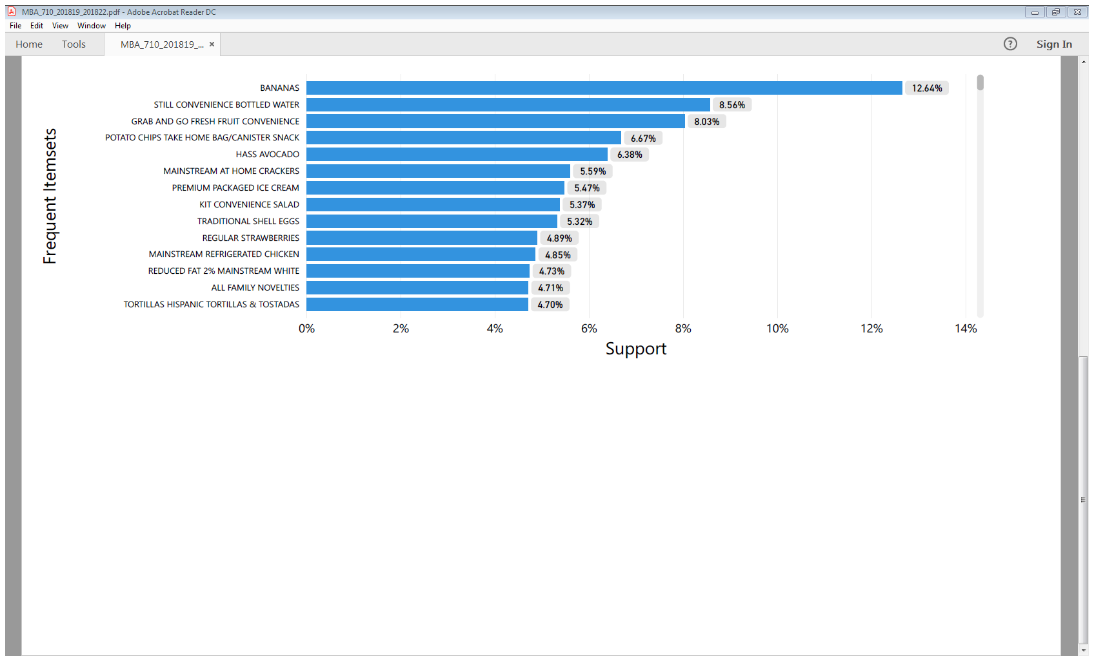
Notes:
Here is a bar chart in the same report showing the support of the frequent itemsets that passed through Apriori algorithms minimum support threshold.

Slide 13

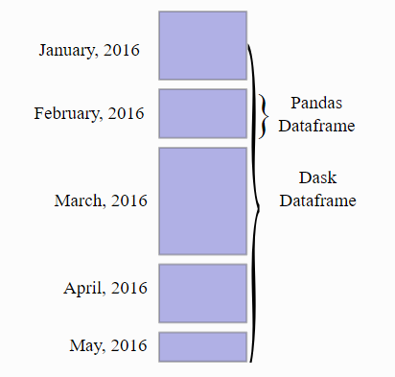

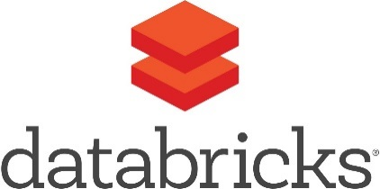
POC to Product
Performance
Move the compute to Azure to take advantage of robust cloud computing.
Extend the minimum support to broader number to include wide range of product associations.
Explore other libraries and methods
Perform nested affinity analysis across multiple product hierarchies to optimize association results at UPC level.
Compare other libraries like Dask data frames, FP-Growth algorithm, Arules with R, Databricks, etc.
Notes:
Performance: The market basket analysis I performed was for a single store in a 3-week time frame. This dataset contained over 800,000 records! In order to look at larger datasets, we must move the compute to Azure to take advantage of robust cloud computing. With minimal changes to my program, Albertsons will be able to perform market basket analysis across all stores.
Nested Affinity: Allows us to run market basket analysis across multiple product hierarchies. This means association rules will be even more insightful.
Other Methods: I only used one unsupervised machine learning algorithm, Apriori. There are many other machine learning algorithms that can used to perform market basket analysis. In the future, Albertsons needs to explore other algorithms in order to compare and choose the best output.

Slide 14
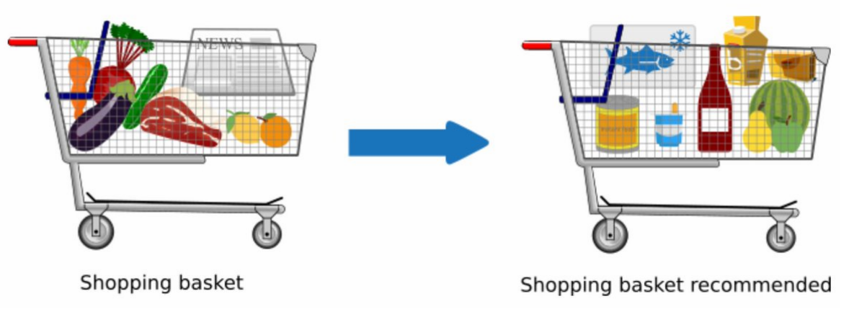
Power of market basket analysis
With the ability to measure the associations between our customers baskets we can improve their shopping experience.
Store layout and content placement
Promotions and marketing messages
Customer insights
Recommendation engines and other machine learning algorithms
Notes:
When we go grocery shopping, we often have a standard list of things to buy. Each shopper has a distinctive list, depending on one’s needs and preferences. A housewife might buy healthy ingredients for a family dinner, while a bachelor might buy beer and chips. If there is a pair of items, X and Y, that are frequently bought together, understanding these buying patterns can help to increase sales in several ways.
Store Layout: If we understand the associations between products, we can change store layout to try to increase our customers basket size.
Promotions: Sales managers will be able to avoid placing associated itemsets together in the ad, saving valuable ad space.
Customer Insights: Buying habits are unique at each one of our stores. We will be able to tailor stores to our customers tastes and preferences, again increasing basket size.
Recommendation Engines: For a recommendation engine to work, it must know what products are associated to each other. With the combination of customer segmentation, market basket analysis can be a powerful tool in the input of recommendation engines.

Slide 15
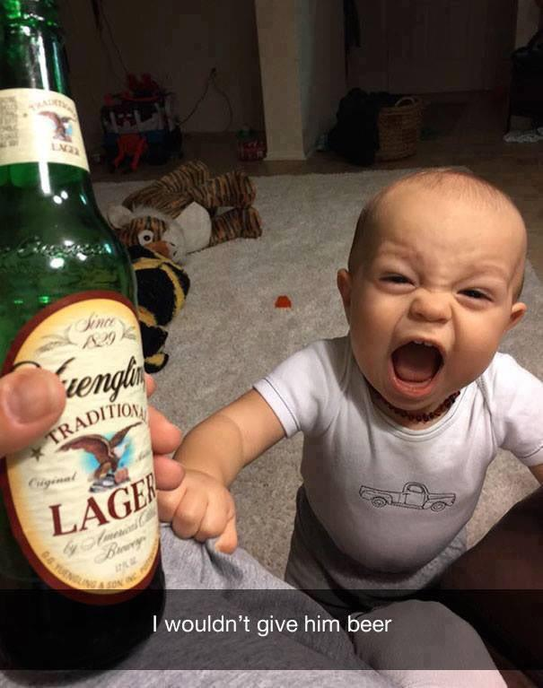
Questions?

Slide 16
References
MLxtend
Raschka, (2018). MLxtend: Providing machine learning and data science utilities and extensions to Python's scientific computing stack. Journal of Open Source Software, 3(24), 638, https://doi.org/10.21105/joss.00638
Python Visualizations with Matplotlib and NetworkX
Hunter, (2007). Matplotlib: A 2D graphics environment. Computing in Science and Engineering, 9(23), 90-95, https://ieeexplore.ieee.org/document/4160265
Hagberg, Schult, Swart (2008). Exploring Network Structure, Dynamics, and Function using NetworkX. Proceedings of the 7th Python in Science conference (SciPy 2008), 11-15, http://conference.scipy.org/proceedings/SciPy2008/paper_2/full_text.pdf
Teradata
Teradata Corporation (2015). Teradata Python Module. https://github.com/Teradata/PyTd
SQLAlchemy
Bayer, (2012) SQLAlchemy. In Amy Brown and Greg Wilson, editors, The Architecture of Open Source Applications Volume II: Structure, Scale, and a Few More Fearless Hacks http://aosabook.org

Slide 17


